Slide 1
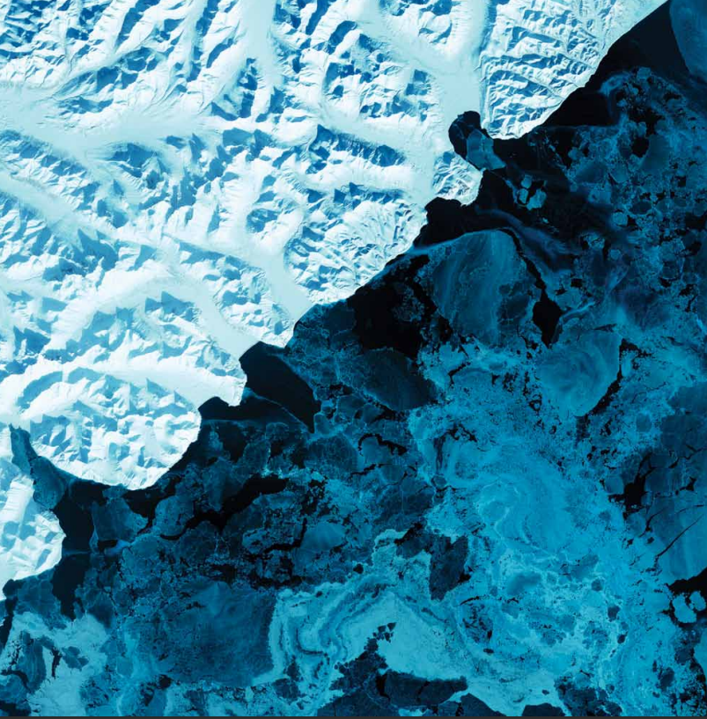
THE ART IN OUR
WORLDS
NasArt Team

Slide 2
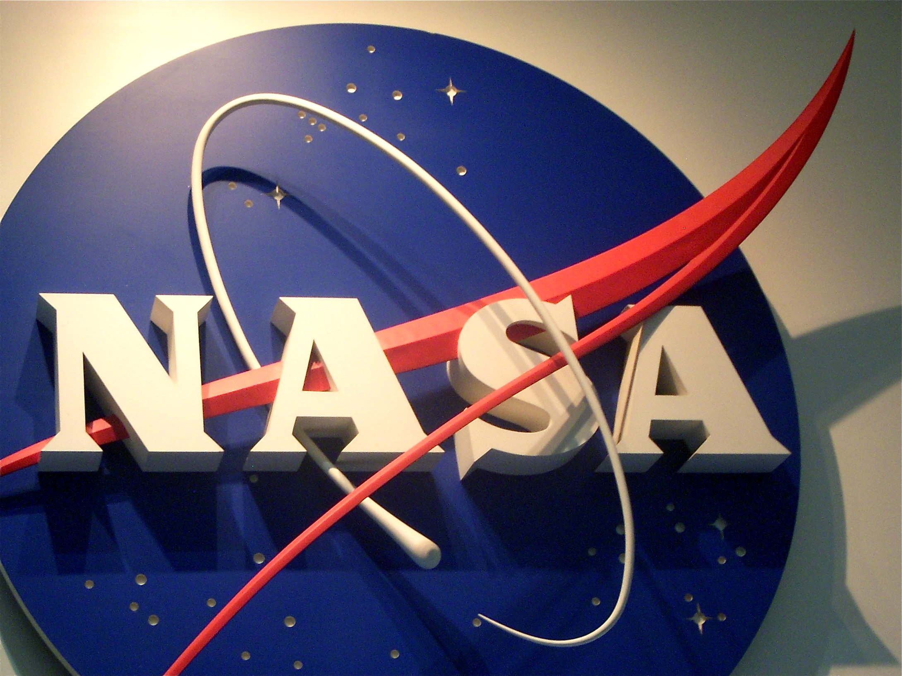

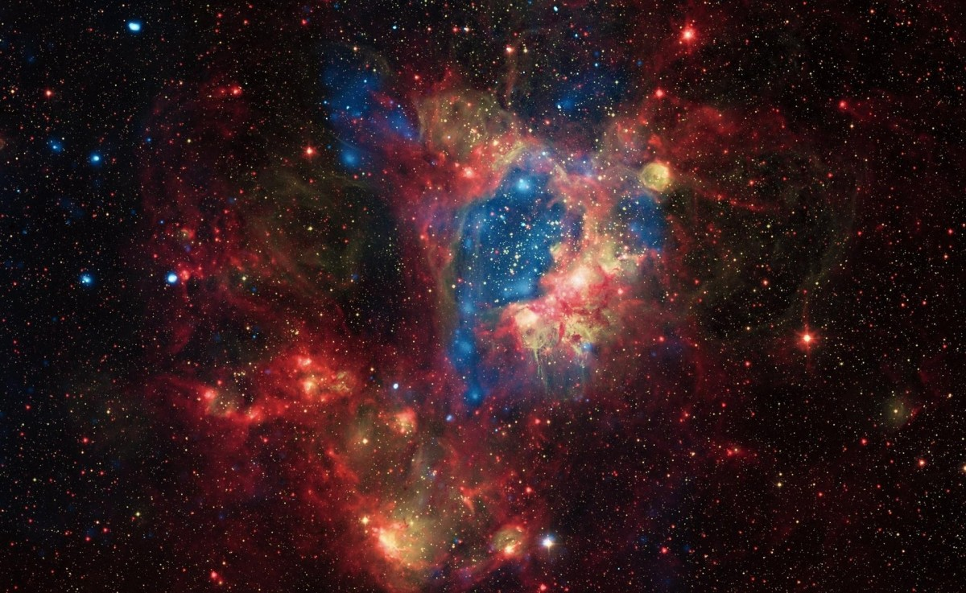
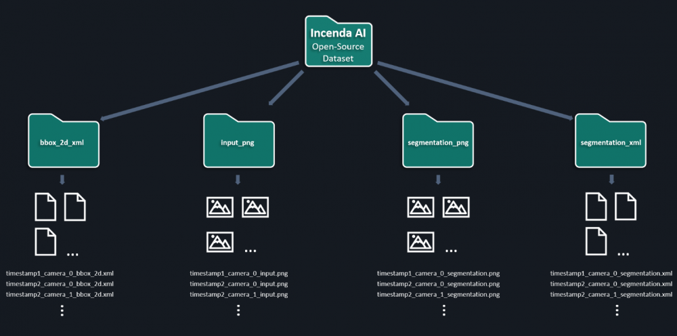
Problem
More accessible to the public

Slide 3
Document-to-document similarity
Creatively manipulating images
Creating text representation for images
Text-to-speech transcription
solution
phases
Speech-to-text Transcription
Web application

Slide 4

Document-to-document similarity
Creatively manipulating images
Creating text representation for images
Text-to-speech transcription
solution
phases
Web application
Speech-to-text Transcription

Slide 5




Speech-to-text Transcription

Slide 6

Document-to-document similarity
Creatively manipulating images
Creating text representation for images
Text-to-speech transcription
solution
phases
Speech-to-text Transcription
Web application

Slide 7
Document-to-document similarity
Creatively manipulating images
Creating text representation for images
Text-to-speech transcription
solution
phases
Web application
Speech-to-text Transcription

Slide 8



Creating text representation for images

Slide 9
Document-to-document similarity
Creatively manipulating images
Creating text representation for images
Text-to-speech transcription
solution
phases
Speech-to-text Transcription
Web application

Slide 10
Document-to-document similarity
Creatively manipulating images
Creating text representation for images
Text-to-speech transcription
solution
phases
Speech-to-text Transcription
Web application

Slide 11



Document-to-document similarity

Slide 12
Document-to-document similarity
Creatively manipulating images
Creating text representation for images
Text-to-speech transcription
solution
phases
Speech-to-text Transcription
Web application

Slide 13
Document-to-document similarity
Creatively manipulating images
Creating text representation for images
Text-to-speech transcription
solution
phases
Speech-to-text Transcription
Web application

Slide 14
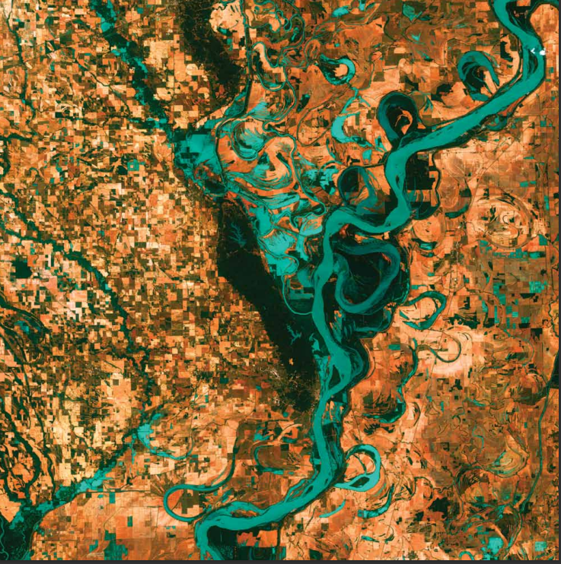
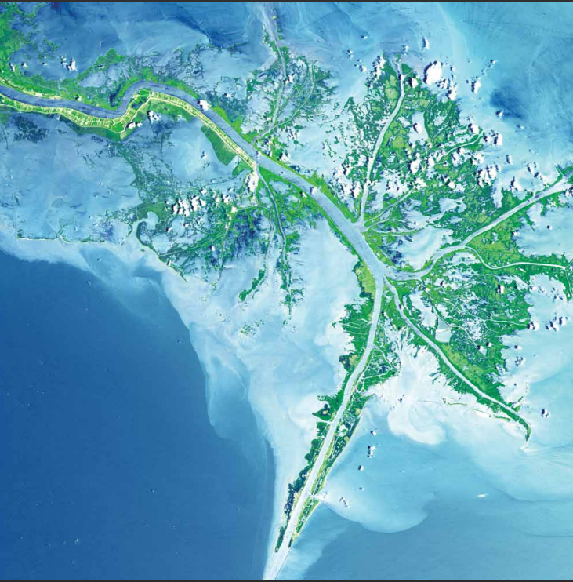

Creatively manipulating images

Slide 15
Document-to-document similarity
Creatively manipulating images
Creating text representation for images
Text-to-speech transcription
solution
phases
Speech-to-text Transcription
Web application

Slide 16
Document-to-document similarity
Creatively manipulating images
Creating text representation for images
Text-to-speech transcription
solution
phases
Speech-to-text Transcription
Web application

Slide 17
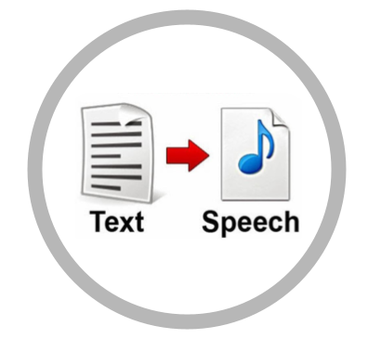
Text-to-speech transcription

Slide 18
Document-to-document similarity
Creatively manipulating images
Creating text representation for images
Text-to-speech transcription
solution
phases
Speech-to-text Transcription
Web application

Slide 19
Document-to-document similarity
Creatively manipulating images
Creating text representation for images
Text-to-speech transcription
solution
phases
Speech-to-text Transcription
Web application

Slide 20
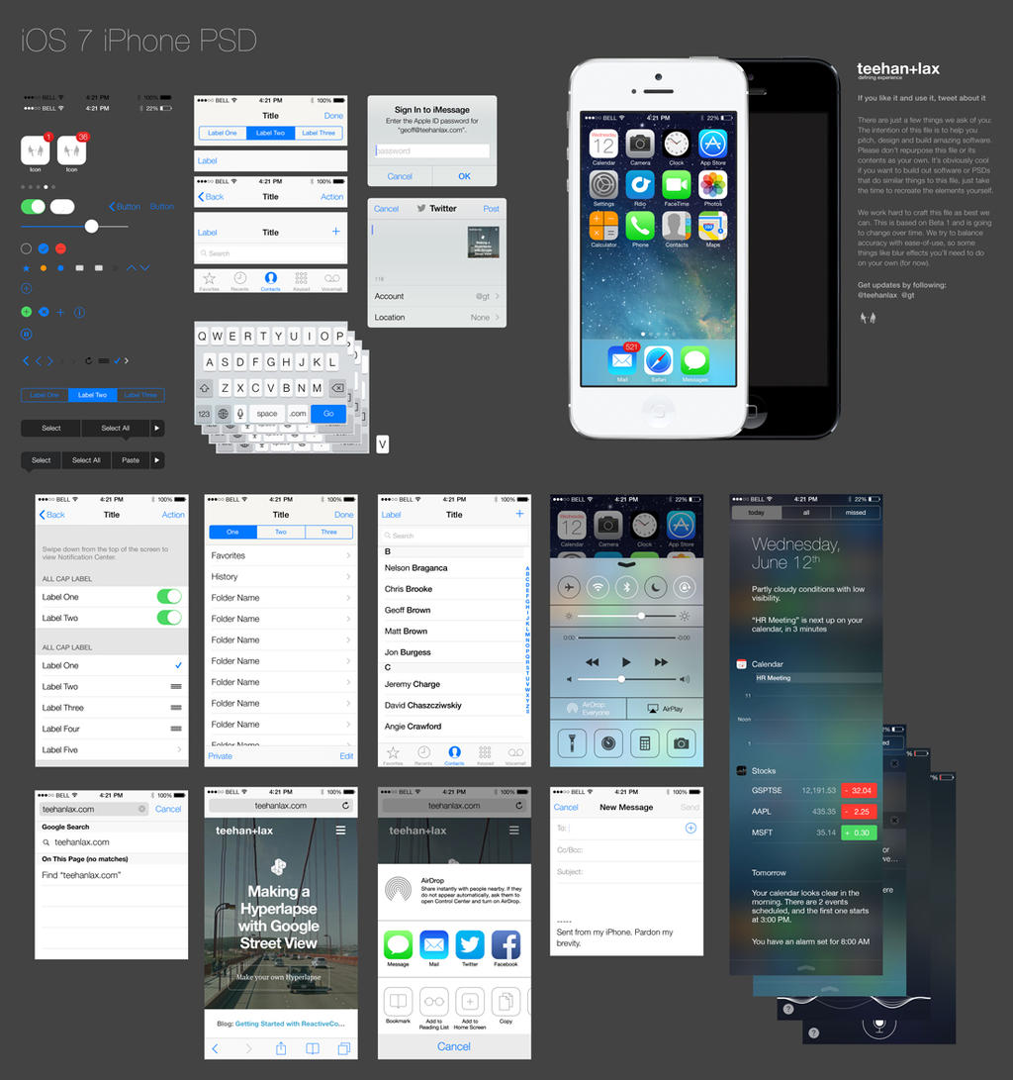
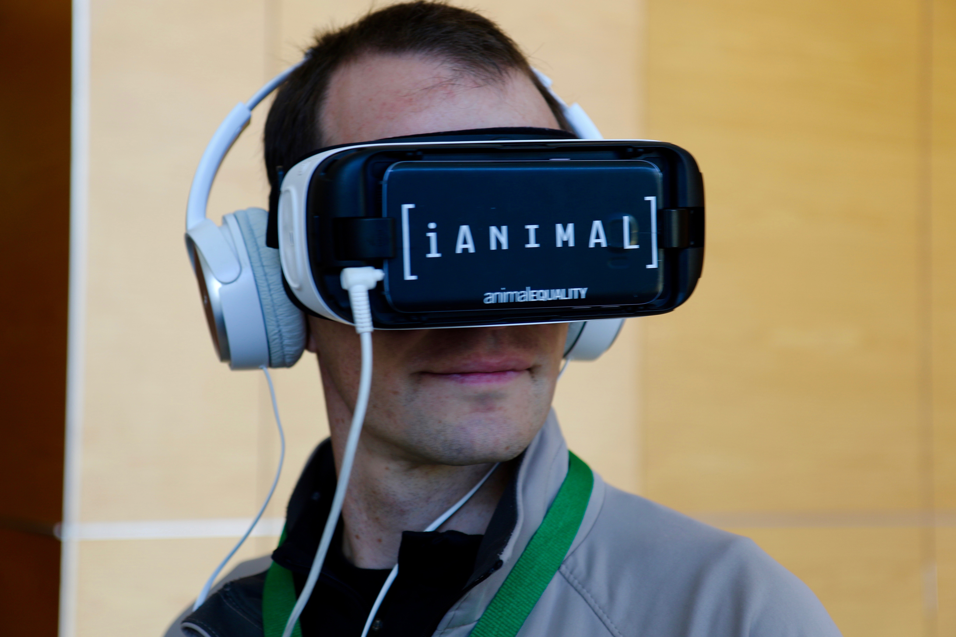
Web application

Slide 21
Document-to-document similarity
Creatively manipulating images
Creating text representation for images
Text-to-speech transcription
solution
phases
Speech-to-text Transcription
Web application

Slide 22
“The space is the breath of art”

